Slide 1
Online Toll Cash Collection System For Road Transportation
Presented by:-
Jasmeen Kaur 1707986
Anisha 1707971
Tarandeep Singh 1708012
Rinki Pal 1708006
Parveen Kaur 1708003

Slide 2
What is online toll cash collection system for road transportation?
Toll Plaza Payment systems have been of great assistance in lowering the over traffic congestion that has become a part of the metropolitan cities these days.
It is one of the best ways to manage the great run of traffic. The travelers passing through this mode of transport must pay toll by waiting in long queue, so it leads to problems like fuel wastage, time wastage, pollution, and burden of carrying cash.

Slide 3
.
Thus by using our system traveler relieves the burden of waiting in the queue to make the toll payment, which decreases the fuel-consumption and also taking cash with them can be avoided.
So by using our system User can just only show the message in their inbox by paying online, and so that user doesn’t need to wait at the tollgate for a long time .

Slide 4
Objectives:-
1. This will allow people to pay their highway tolls online without needing to stop at the toll plaza.
2. Cashless transaction at toll plaza.
3. Cut down the travelling time on highways.
4. Relief to commuters on national highways(NHs).
5. To improve quality of work and accuracy.
6. To improve work speed and accuracy.
7. To provide the easy and user friendly environment.

Slide 5
Benefits of this system:-
Fewer or shorter queues of vehicles at toll plazas by increasing toll plaza service turnaround rates.
Fast and more efficient service.
Ability to make payments by keeping a balance on the card itself.
Other general advantages include minimization of fuel wastage and reduced emissions by reducing deceleration rate, waiting time of vehicles in queue, and acceleration.

Slide 6
For the toll operators, the benefits include:-
Low toll collection costs.
Better management by centralized user account .
Thus, this system is useful for both the travelers and toll operators, this is the reason why this system will be useful throughout the world.

Slide 7
Structural Design
Database plays an important role in system.
Database system is divided into three parts:
Administrator
Central database
Integrated database.

Slide 8
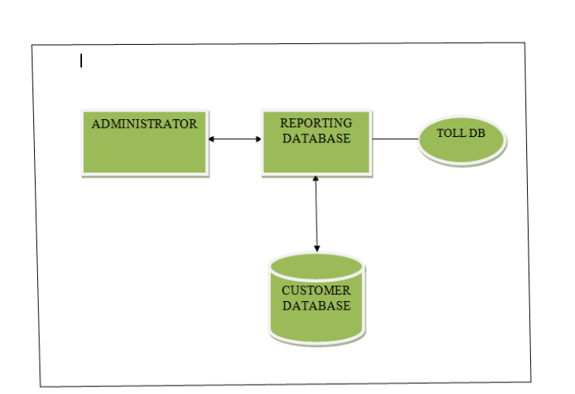
Database Structure

Slide 9
Administrator :
1. Admin database contains all the details of central database and all toll plazas under Construction.
Central database:
1. Centralized system is heart of database.
2. Central database consist records of all toll plazas under that construction.
3. This central database managed by administrator.

Slide 10
.
4. The customer must register into this account to use this system.
5.This account information about is stored into the RTO database.
6.When the registered customer passes through the particular toll plazas then, automatically toll will be deducted from customer's account.
7.This deduction will be updated by central database.

Slide 11
.
Integrated database:
1. Integrated database is connected to the central database.
2. Integrated database consist of RTO database.
3. This database will update automatically.
4. RTO database includes all registered vehicles and the details of vehicle such as vehicle owner, vehicle number, license number, account ID, account balance, current charges, etc.

Slide 12
Conclusion
One of the most important impacts of technology is the development of sustainable technologies that reduce the traffic conjunction and that need of future generation, save energy and time.
Our project mainly impact full in these aspects, by saving the time on the toll, and also for to save fuel and by regulating the pollution and usage of vehicle at toll gates; as shown it makes the toll collection payment easy by using automatic toll cash collection process .

Slide 13
.
THANK YOU

